Slide 1

Scripting.
Concept and practices
Tatiana Romanciuc
DevOps Engineer

Slide 2
Topics

Slide 3
Topics
What is scripting?

Slide 4
Topics
What is scripting?
What scripting languages are used in DevOps?

Slide 5
Topics
What is scripting?
What scripting languages are used in DevOps?
When to use a script?

Slide 6
Topics
What is scripting?
What scripting languages are used in DevOps?
When to use a script?
What are best practices for scripting?

Slide 7

What is a script?

Slide 8
Script - file with a code/commands set which can be executed without being compiled.

Slide 9

Script = Automation

Slide 10
When to use a script?

Slide 11
When to use a script?
For tasks that has to be run on schedule

Slide 12
When to use a script?
For tasks that has to be run on schedule
Backup processes

Slide 13
When to use a script?
For tasks that has to be run on schedule
Backup processes
Deleting/ creating/ deactivating / restarting resources

Slide 14
When to use a script?
For tasks that has to be run on schedule
Backup processes
Deleting/ creating/ deactivating / restarting resources
Update / Upgrade tasks
Etc.

Slide 15
When to use a script?
For tasks that has to be run on-schedule
When speed of execution and details matters

Slide 16
When to use a script?
For tasks that has to be run on-schedule
When speed of execution and details matters
Troubleshooting

Slide 17
When to use a script?
For tasks that has to be run on-schedule
When speed of execution and details matters
Troubleshooting
Data extraction and analysis

Slide 18
When to use a script?
For tasks that has to be run on-schedule
When speed of execution and details matters
Troubleshooting
Data extraction and analysis
Maintenance work

Slide 19
When to use a script?
For tasks that has to be run on-schedule
When speed of execution and details matters
In order to automate the process of code delivery (CI/CD)

Slide 20
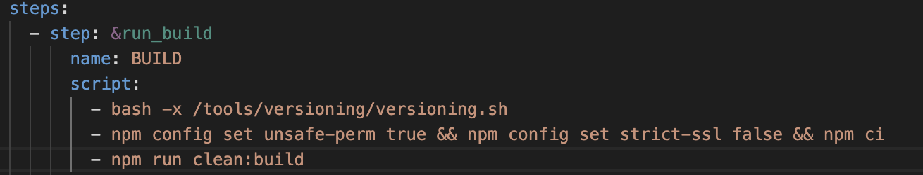
When to use a script?
For tasks that has to be run on-schedule
When speed of execution and details matters
In order to automate the process of code delivery (CI/CD)
Code build

Slide 21
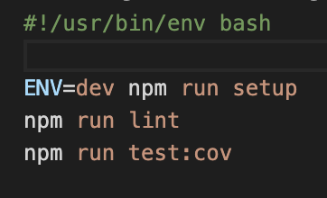
When to use a script?
For tasks that has to be run on-schedule
When speed of execution and details matters
In order to automate the process of code delivery (CI/CD)
Code build
Running tests

Slide 22
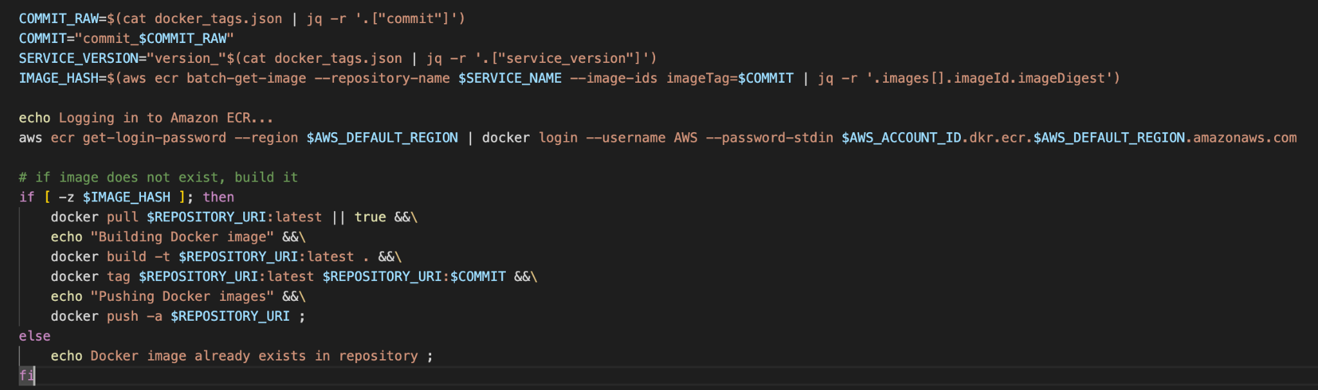
When to use a script?
For tasks that has to be run on-schedule
When speed of execution and details matters
In order to automate the process of code delivery (CI/CD)
Code build
Running tests
Building docker images

Slide 23
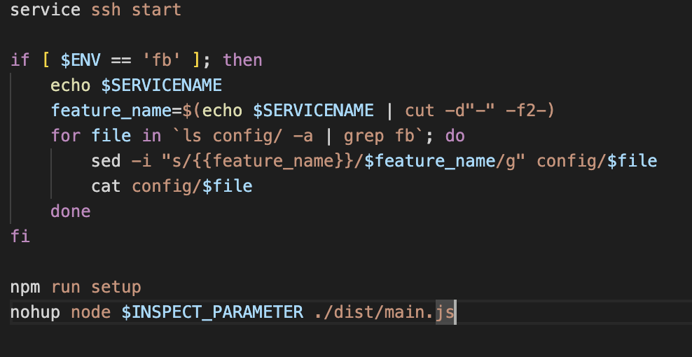
When to use a script?
For tasks that has to be run on-schedule
When speed of execution and details matters
In order to automate the process of code delivery (CI/CD)
Code build
Running tests
Building docker images
Application starting and setup

Slide 24
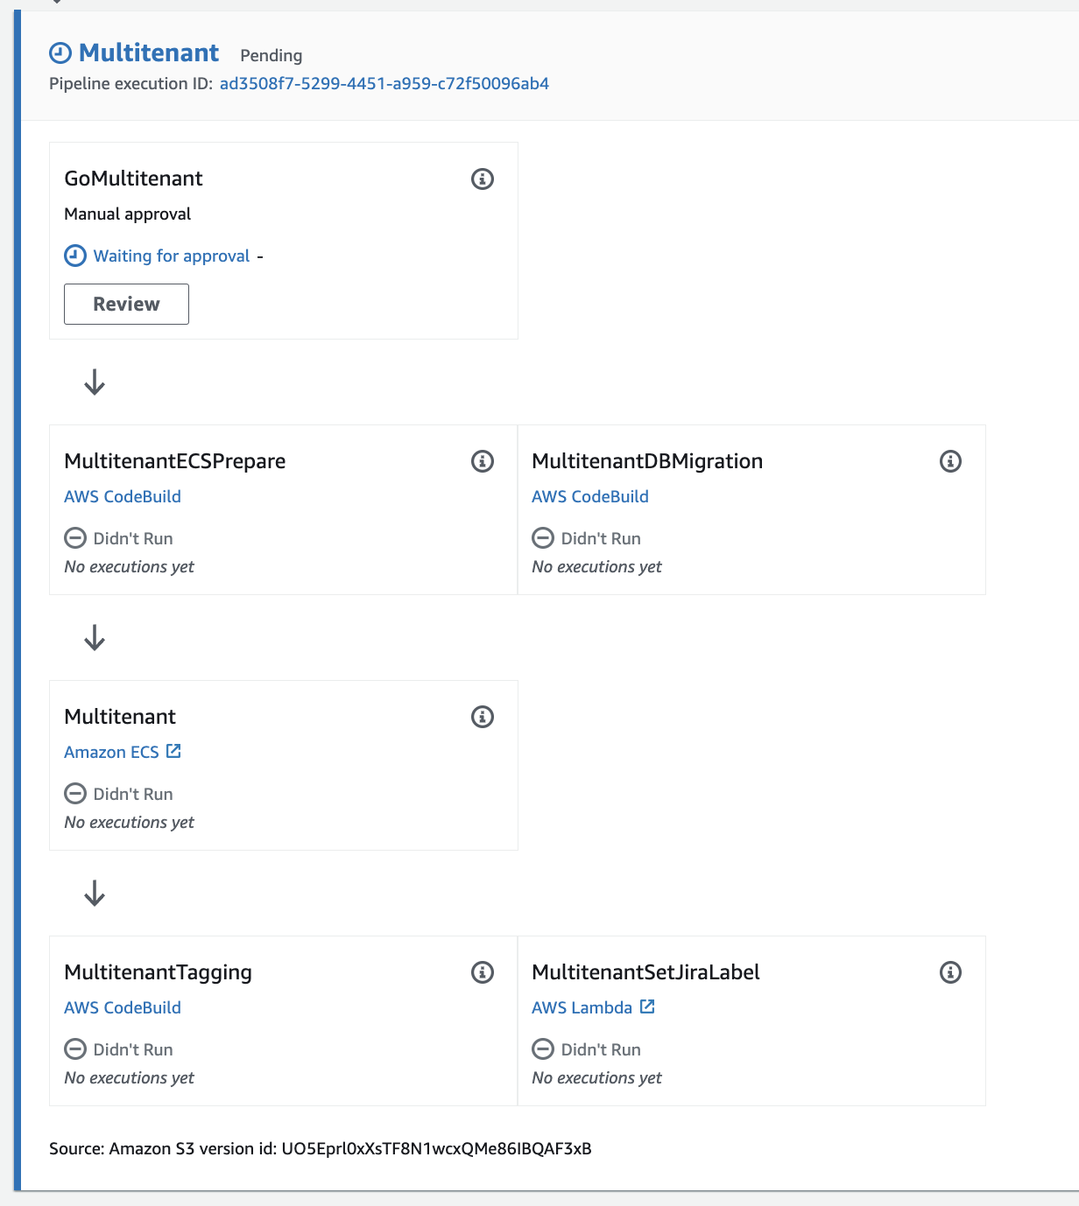
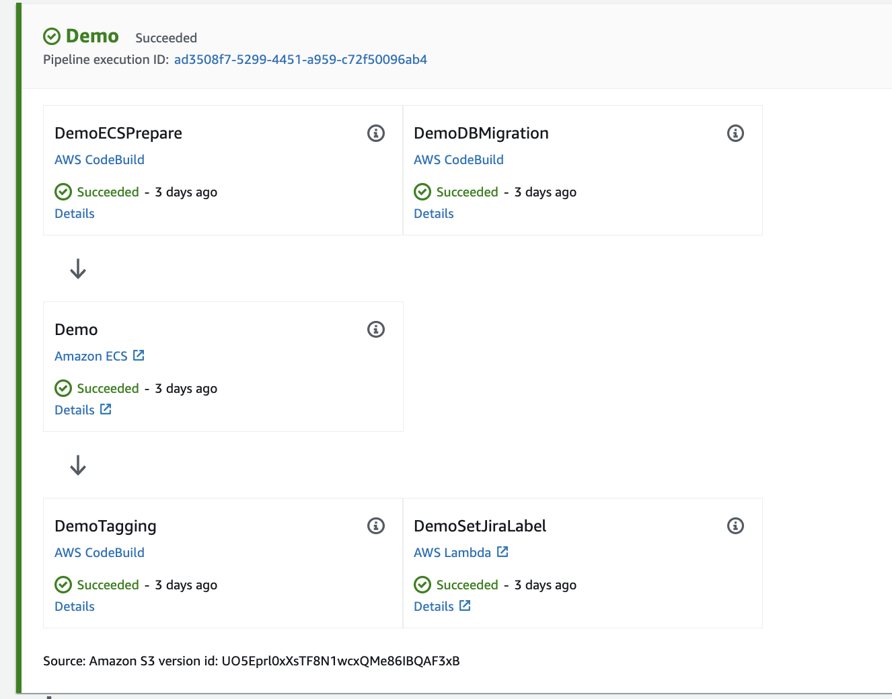
When to use a script?

Slide 25
Scripting languages used in DevOps

Slide 26
Scripting languages used in DevOps
Bash

Slide 27
Scripting languages used in DevOps
Bash
Powershell

Slide 28
Scripting languages used in DevOps
Bash
Powershell

Slide 29
Scripting languages used in DevOps
Bash
Powershell
Groovy

Slide 30
Scripting languages used in DevOps
Bash
Powershell
Groovy
Python

Slide 31
Scripting best practices

Slide 32
Scripting best practices
Easy to read code

Slide 33
Scripting best practices
Easy to read code
Use self-descriptive names for variables and functions

Slide 34
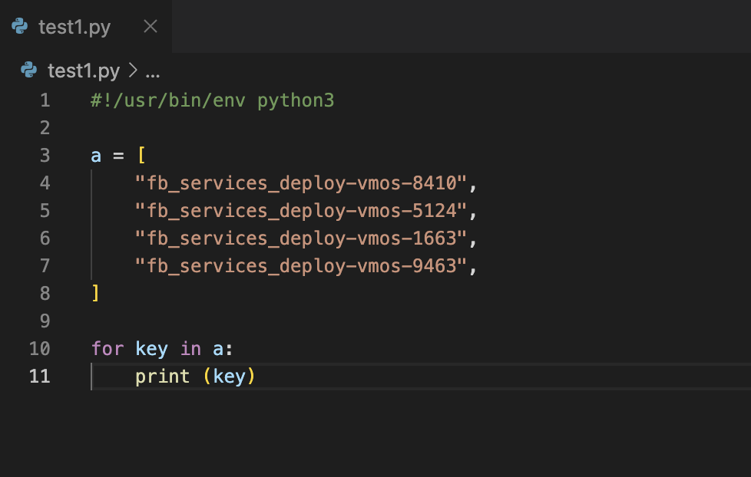
Scripting best practices
Easy to read code
Use self-descriptive names for variables and functions

Slide 35
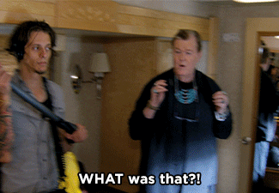
Scripting best practices
Easy to read code
Use self-descriptive names for variables and functions

Slide 36
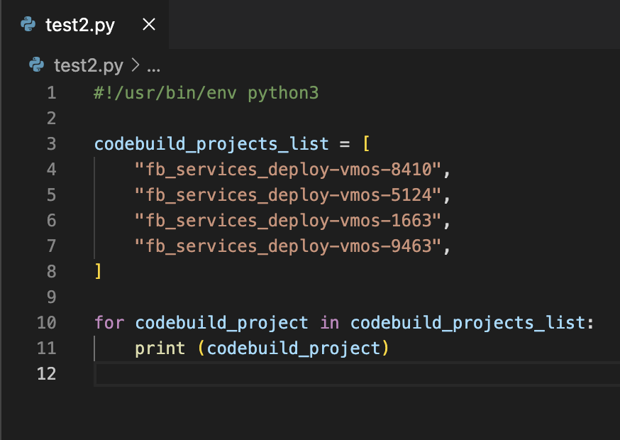
Scripting best practices
Easy to read code
Use self-descriptive names for variables and functions

Slide 37
Scripting best practices
Easy to read code
Use self-descriptive names for variables and functions
Style the code with spaces and empty lines

Slide 38
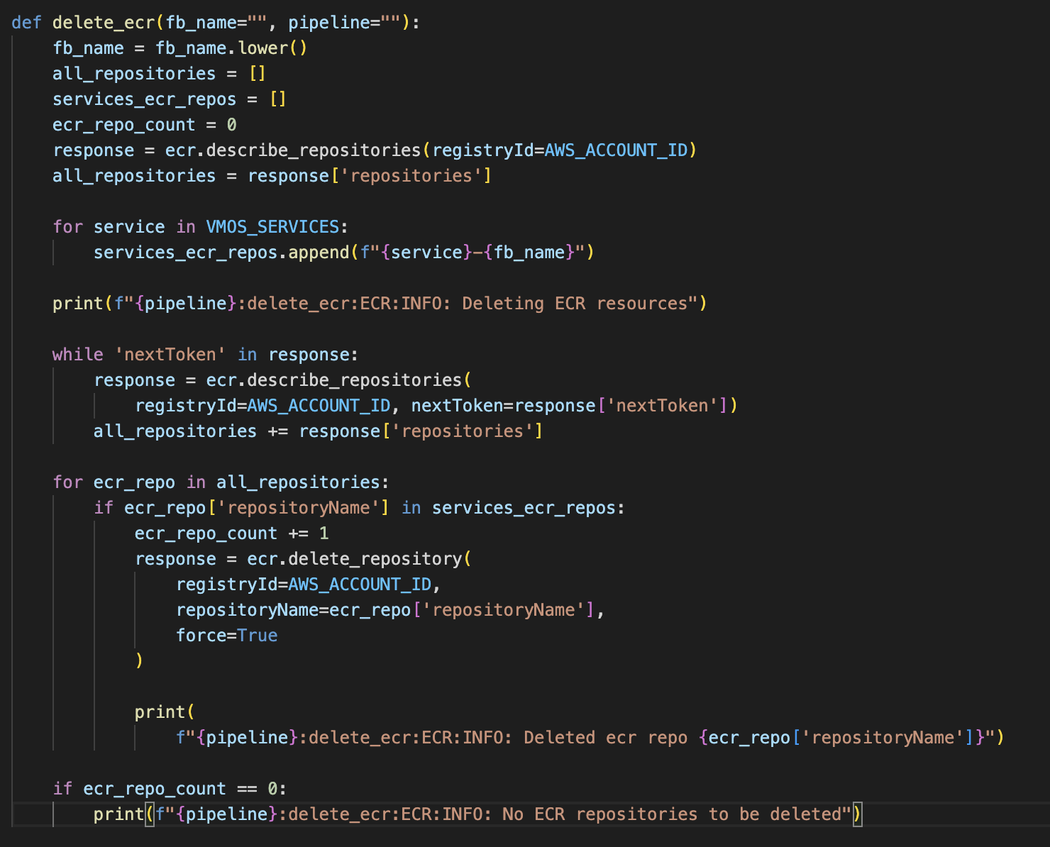
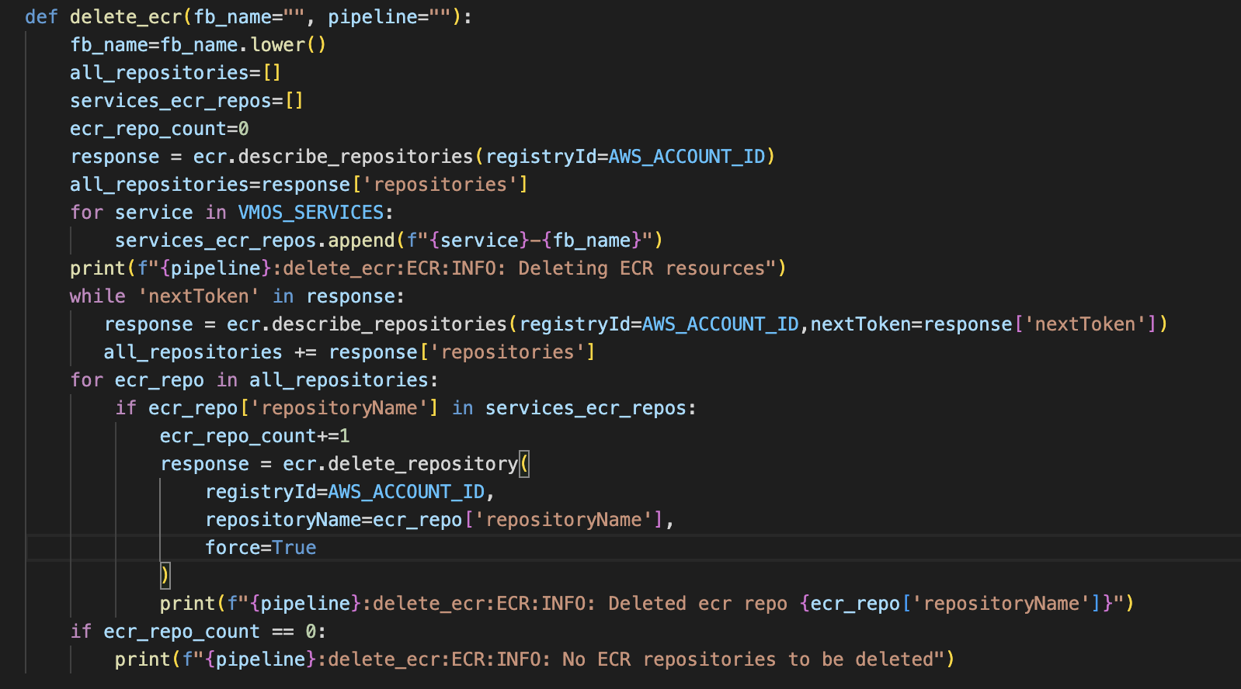
Scripting best practices
Easy to read code
Use self-descriptive names for variables and functions
Style the code with spaces and empty lines

Slide 39
Scripting best practices
Easy to read code
Use self-descriptive names for variables and functions
Style the code with spaces and empty lines
Use comments in code

Slide 40
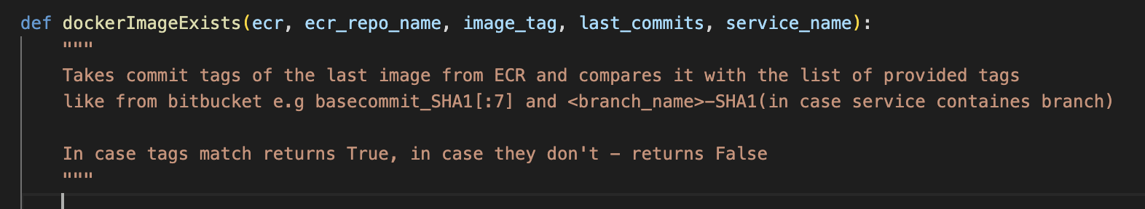
Scripting best practices
Easy to read code
Use self-descriptive names for variables and functions
Style the code with spaces and empty lines
Use comments in code

Slide 41
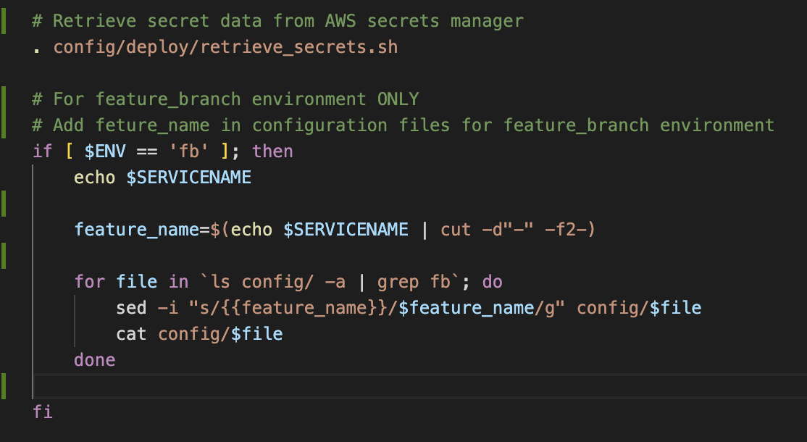
Scripting best practices
Easy to read code
Use self-descriptive names for variables and functions
Style the code with spaces and empty lines
Use comments in code

Slide 42
Scripting best practices
Easy to read code
Use self-descriptive names for variables and functions
Style the code with spaces and empty lines
Use comments in code
Short code lines

Slide 43
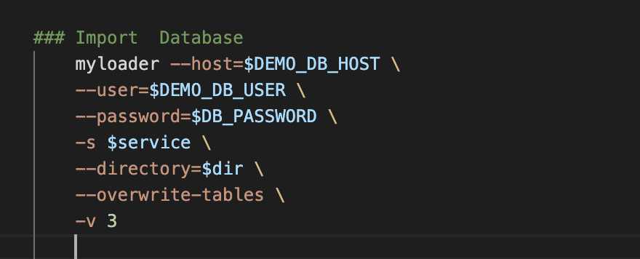
Scripting best practices
Easy to read code
Use self-descriptive names for variables and functions
Style the code with spaces and empty lines
Use comments in code
Short code lines

Slide 44
Scripting best practices
Easy to read code
No hardcode or sensitive data

Slide 45
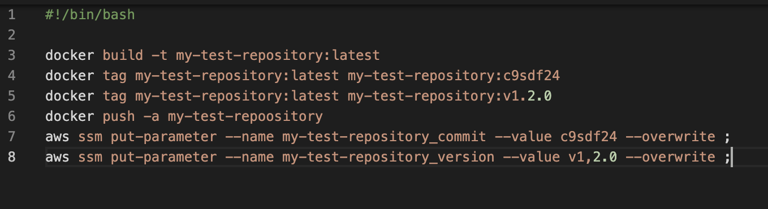
Scripting best practices
Easy to read code
No hardcode or sensitive data

Slide 46
Scripting best practices
Easy to read code
No hardcode or sensitive data

Slide 47
Scripting best practices
Easy to read code
No hardcode or sensitive data

Slide 48
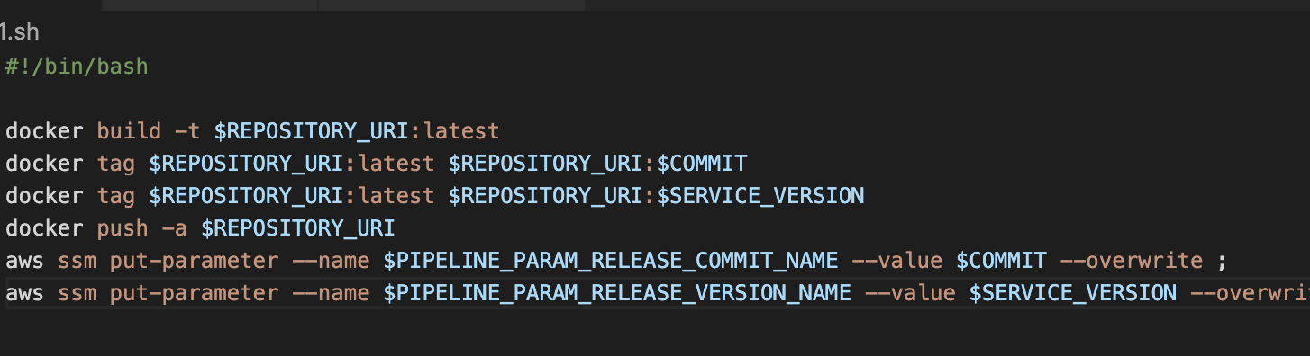
Scripting best practices
Easy to read code
No hardcode or sensitive data

Slide 49
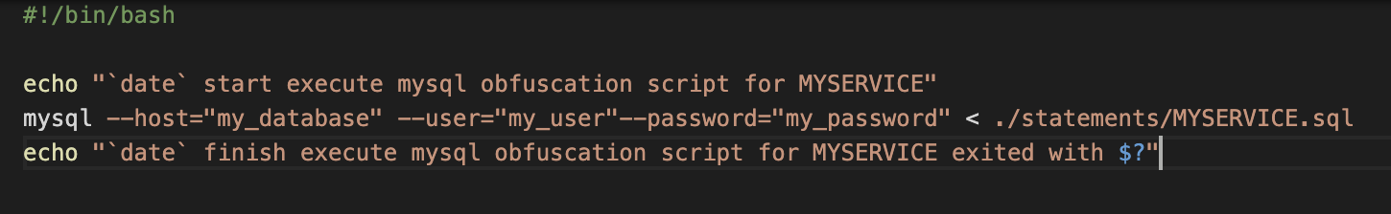
Scripting best practices
Easy to read code
No hardcode or sensitive data

Slide 50
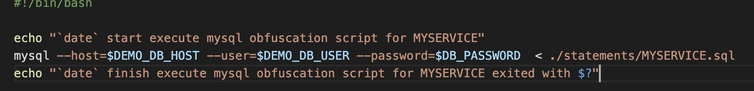
Scripting best practices
Easy to read code
No hardcode or sensitive data

Slide 51
Scripting best practices
Easy to read code
No hardcode or sensitive data
Split the code into smaller functions

Slide 52
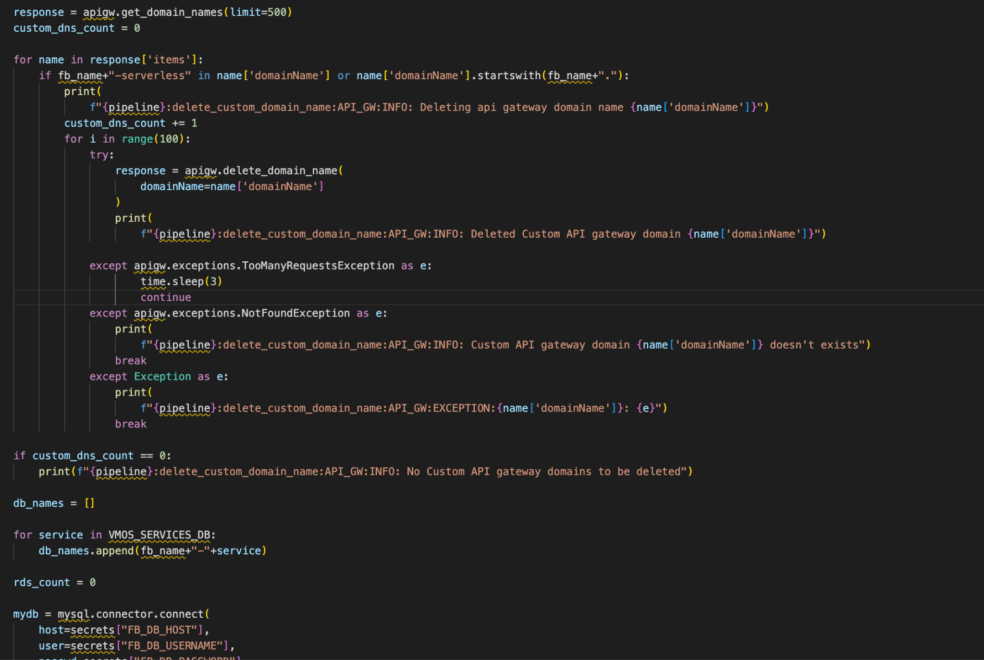
Scripting best practices
Easy to read code
No hardcode or sensitive data
Split the code into smaller functions

Slide 53
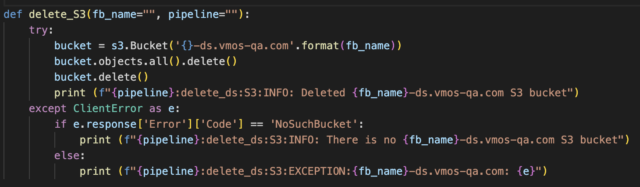
Scripting best practices
Easy to read code
No hardcode or sensitive data
Split the code into smaller functions

Slide 54
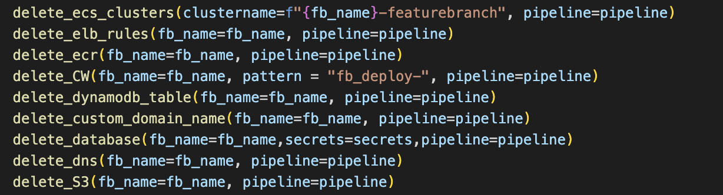
Scripting best practices
Easy to read code
No hardcode or sensitive data
Split the code into smaller functions

Slide 55
Scripting best practices
Easy to read code
No hardcode or sensitive data
Split the code into smaller functions
Do a proper logging

Slide 56
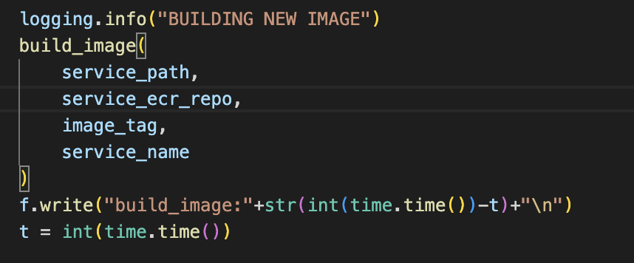
Scripting best practices
Easy to read code
No hardcode or sensitive data
Split the code into smaller functions
Do a proper logging

Slide 57
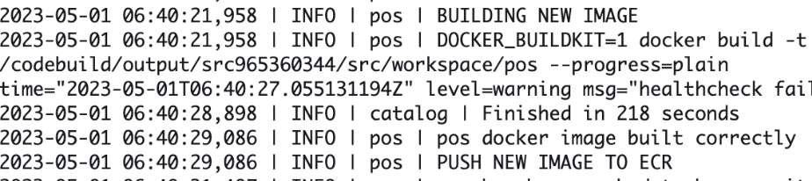
Scripting best practices
Easy to read code
No hardcode or sensitive data
Split the code into smaller functions
Do a proper logging

Slide 58
Scripting best practices
Easy to read code
No hardcode or sensitive data
Split the code into smaller functions
Do a proper logging
Plan the script before start writing it

Slide 59
Scripting best practices
Easy to read code
No hardcode or sensitive data
Split the code into smaller functions
Do a proper logging
Plan the script before start writing it
What is the scope of the script? What will it do?

Slide 60
Scripting best practices
Easy to read code
No hardcode or sensitive data
Split the code into smaller functions
Do a proper logging
Plan the script before start writing it
What is the scope of the script? What will it do?
What are the steps to achieve the result?

Slide 61
Scripting best practices
Easy to read code
No hardcode or sensitive data
Split the code into smaller functions
Do a proper logging
Plan the script before start writing it
What is the scope of the script? What will it do?
What are the steps to achieve the result?
What is the most suitable language to be used?

Slide 62
Scripting best practices
Easy to read code
No hardcode or sensitive data
Split the code into smaller functions
Do a proper logging
Plan the script before start writing it
What is the scope of the script? What will it do?
What are the steps to achieve the result?
What is the most suitable language to be used?
How should errors be handled?

Slide 63

Happy Sripting !

